Slide 1


Stack Spoofing with Synthetic Frames
Stack Spoofing with Synthetic Frames

Slide 2


$ whoami
3rd Year CIS @ Cal Poly Pomona
Offensive Security @ White Knight Labs
Previously Pentest Intern @ IBM X-Force Red
@nigerald/susMdT/d_tranman
https://dtsec.us
OSCP, CRTO, CRTL
Windows Internals, Malware Development

Slide 3

Agenda
What is a Call Stack?
Synthetic Frames
Previous Work
Hands-On

Slide 4
Disclaimer
This is not novel
It’s kinda cool though
This is not a silver bullet

Slide 5

What is a Call Stack?

Slide 6
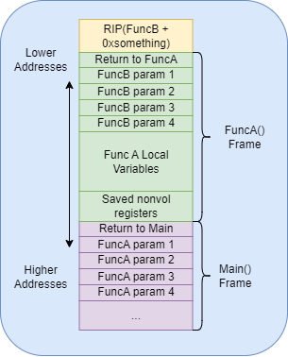
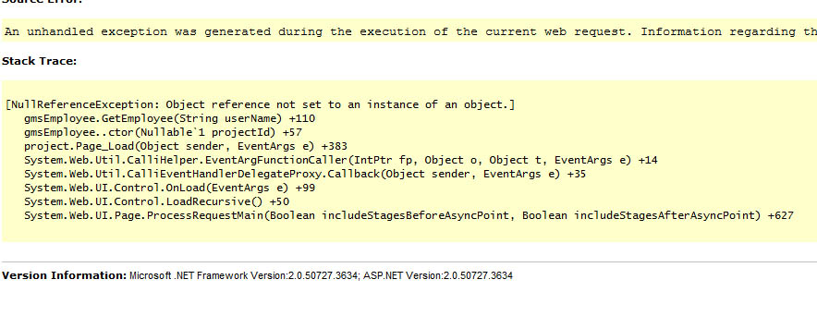
Call Stacks
The stack is a data structure in a process; each thread has one
Call stack is the collection of function calls within the thread
Each entry is commonly referred to as a “frame”
Used in debugging when things crash
https://stackoverflow.com/questions/18012737/what-do-the-numbers-mean-in-a-stack-trace

Slide 7
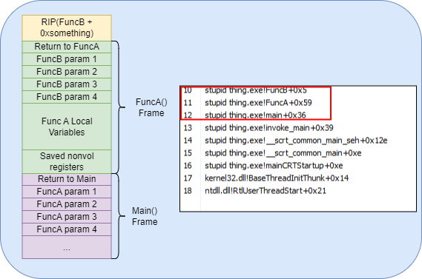
Call Stacks for Detections
When a function is called, the return address is pushed onto the stack, and the callee begins the creation of its frame.
Stack walkers walk the call stack and can see the order of function calls taken to reach a point of execution.

Slide 8
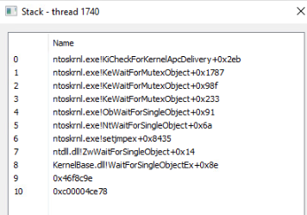
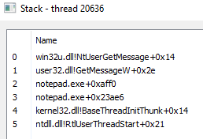
Unbacked Memory
The heap or any private memory (VirtualAlloc) which is not backed by an image (MEM_IMAGE)
Unbacked memory cannot be resolved properly. “Leaky” stack
A normal call stack
A call stack from an unbacked call

Slide 9
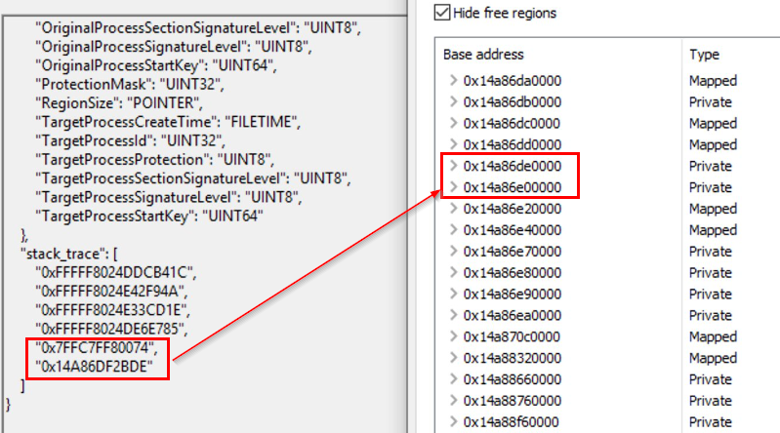
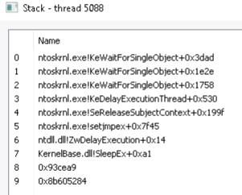
Capturing the Stack
Sleeping Threads
Dynamically
Check call stack of sleeping threads
Kernel callbacks + ETW, hooks
Default Cobalt Strike beacon sleeping
https://twitter.com/domchell/status/1706783600929112550/photo/1

Slide 10
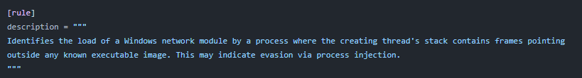

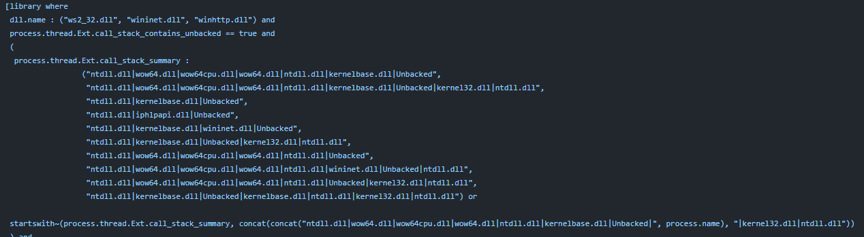
https://github.com/elastic/protections-artifacts/blob/main/behavior/rules/defense_evasion_network_module_loaded_from_suspicious_unbacked_memory.toml

Slide 11
Previous Work

Slide 12
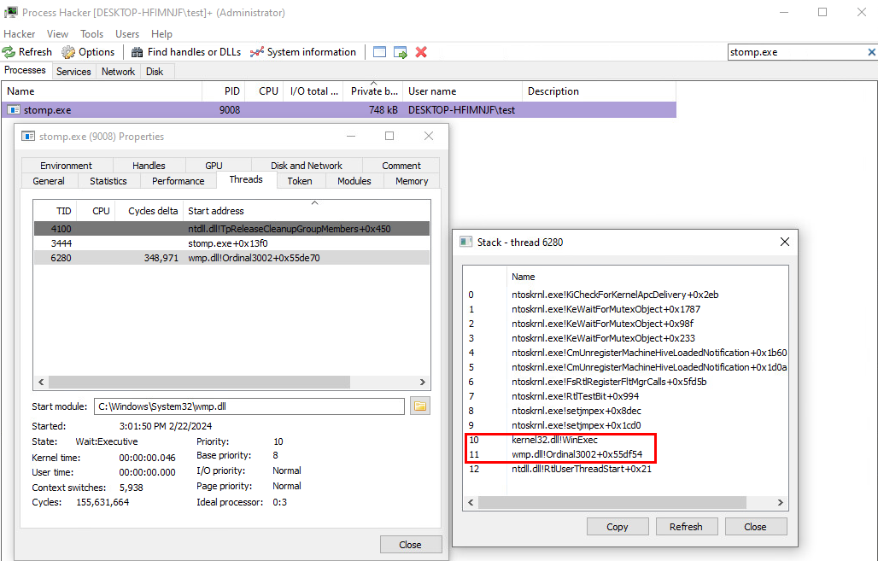
Module Stomping & Mockingjay
Rather than run our shellcode in VirtualAlloc’d memory, overwrite a loaded module’s section and execute from there
Call stack of a module stomped WinExec call

Slide 13
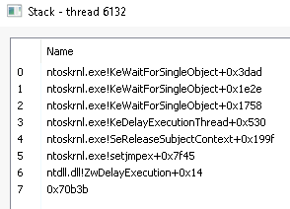
Indirect Syscalls
Use an existing syscall; ret; gadget so the immediate return address is in ntdll
Call stack of an indirect syscall

Slide 14
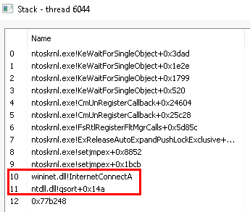
Return Address Patching
Patch return address with a rop/jop gadget to desynchronize execution and obtain an image backed return address
Call stack of a patched InternetConnectA call

Slide 15
The Flaw
These techniques do not mask our entire call stack. We may still have leaky values.
If checks are made beyond the immediate return address, they may flag on this.

Slide 16
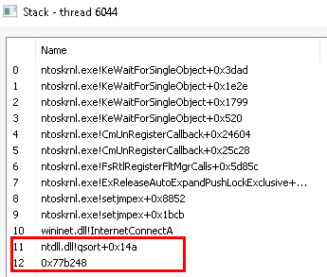
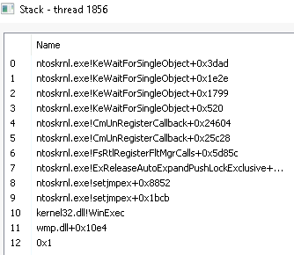
Indirect Syscall
Return Address Patching
Module Stomping

Slide 17
Synthetic Frames

Slide 18
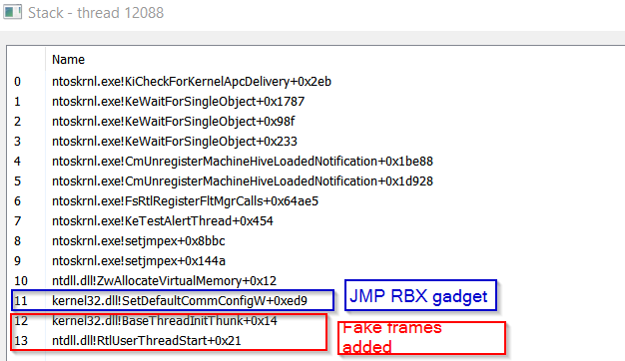
Synthetic Frames in Action
We can expand upon the return address patching technique to build our own frames.
A call stack of an indirect syscall using synthetic frames

Slide 19
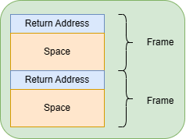
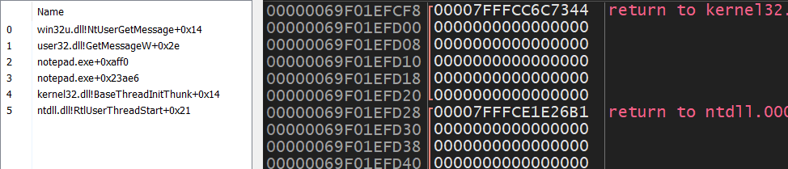
Building a Frame – Frame Structure
Return Addresses
Frame

Slide 20
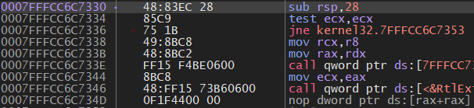
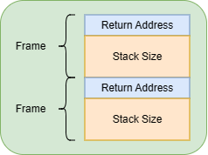
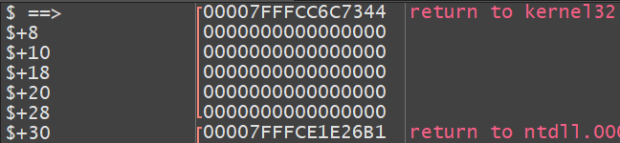
Building a Frame – The Prologue

Slide 21
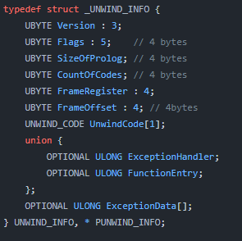
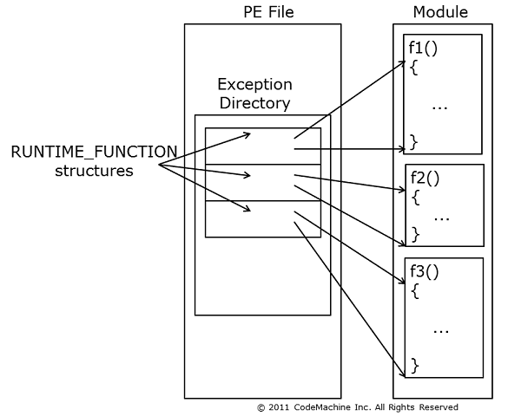
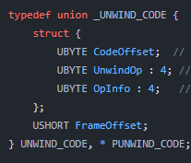
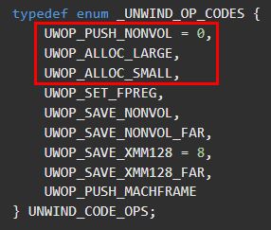
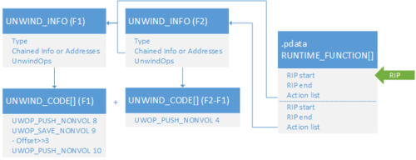
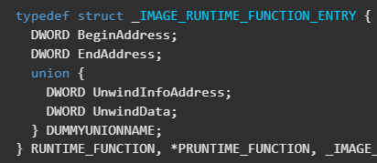
Building a Frame – Calculating Stack Size
https://codemachine.com/articles/x64_deep_dive.html
https://www.leviathansecurity.com/blog/use-of-windows-exception-handling-metadata

Slide 22
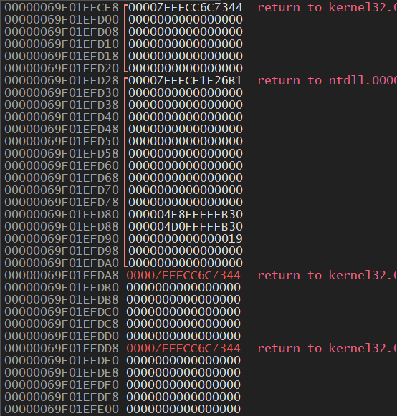
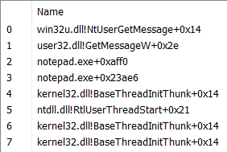
Building a Frame – Synthesis
Real Frames
Synthetic Frames

Slide 23
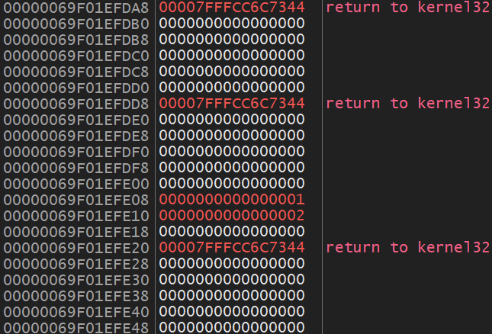
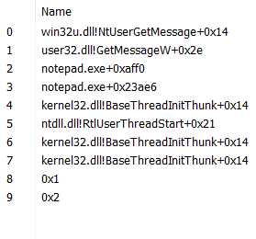
Building a Frame – Terminating a Walk

Slide 24
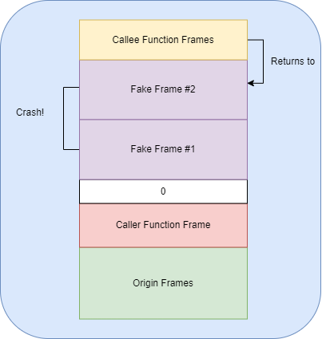
A Problem
By creating fake frames like we have thus far, we can trick a stack walk AND lose execution control
Solution: Combine JOP/ROP from return address patching

Slide 25
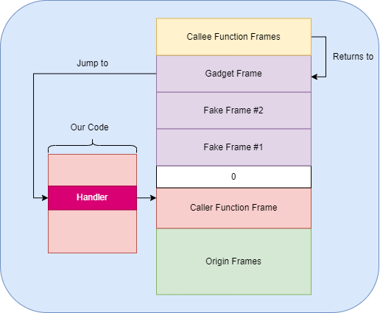
Putting it Together

Slide 26
Hands-On

Slide 27

Questions?

